Slide 1

Session 1.1
Getting Started with Selenium IDE

Slide 2
Topics
Covered
What is Selenium IDE?
Installing Selenium IDE
Recording our first test
Saving tests to be used later
Creating and saving test suites
Running the test/test suite
Running a script line by line
Inserting commands in between script
Introduction Verification and Asserts

Slide 3
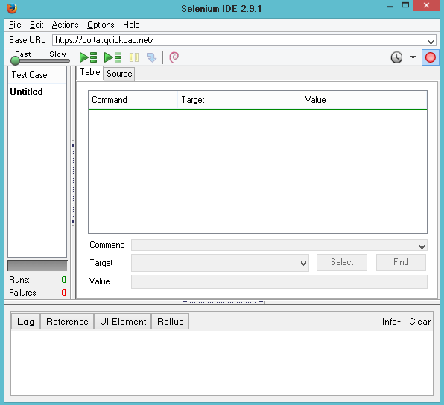

What is Selenium IDE?
Selenium IDE is a Firefox Add-on.
It records your actions as you follow the workflow that they need to test.

Slide 4
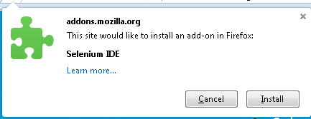
Installing
Selenium IDE
Steps to install the Selenium IDE:
  In Firefox navigate to http://seleniumhq.org/download/.
  On the opened page scroll to the section Selenium IDE, and click on ‘from addons.mozilla.org’ link.
  Click ‘Add to Firefox’ button and wait for below pop up:

Slide 5
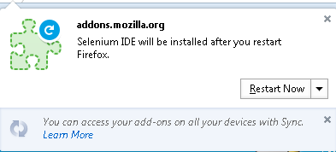
Installing
Selenium IDE
Steps to install the Selenium IDE:
  Click ‘Install’ button and wait for below pop up:
  Click ‘Restart Now’ button and your installation is complete. To verify, Check Add-ons window which will show the Selenium IDE and its current version:

Slide 6
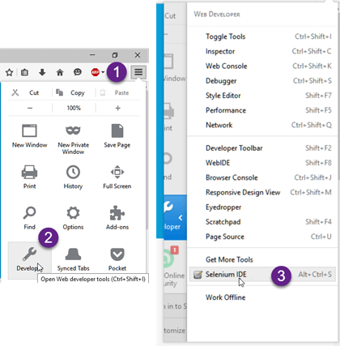
Recording our
first test
To record your first test, launch the Selenium IDE using below two ways:
  By pressing Ctrl+Alt+S
  By clicking on the Firefox menu button>Developer>Selenium IDE

Slide 7
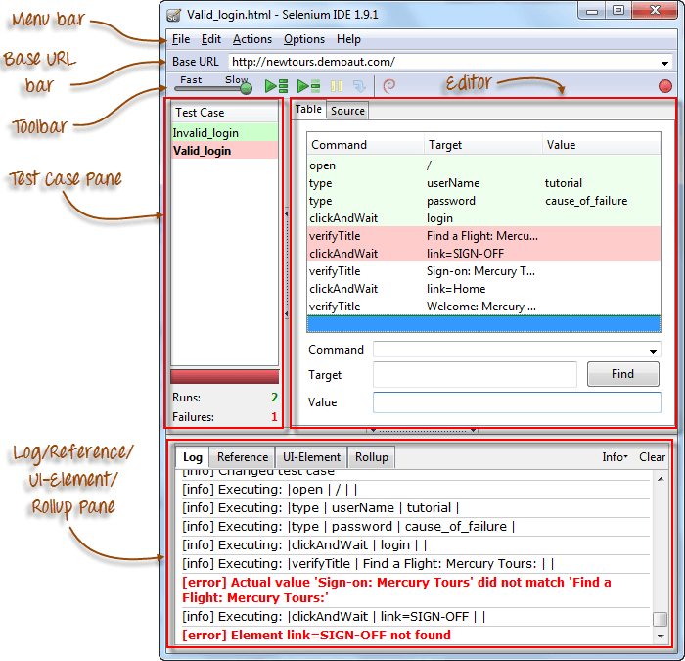
Recording our
first test
Let’s understand the controls first:

Slide 8
Recording our
first test
To start recording your tests let us do the following:
  Enter into recording mode by clicking red icon.
  Enter ‘Base URL’ i.e. http://www.google.co.in in Selenium IDE toolbar.
  Go to Firefox and navigate to the same URL entered into the ‘Base URL’.
  Start performing the operations on page i.e. Enter text, Click etc.. And Selenium IDE will record the same.

Slide 9
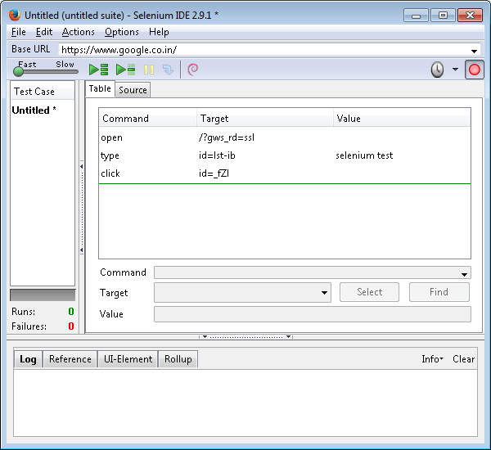
Recording our
first test

Slide 10
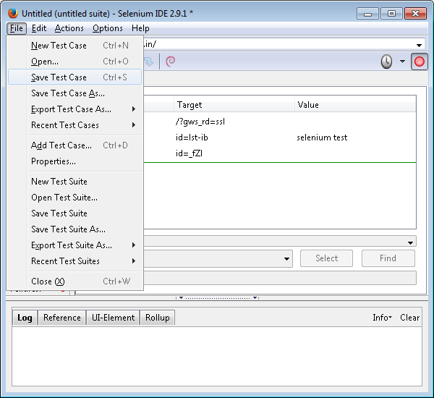
Saving tests to be
used later

Slide 11
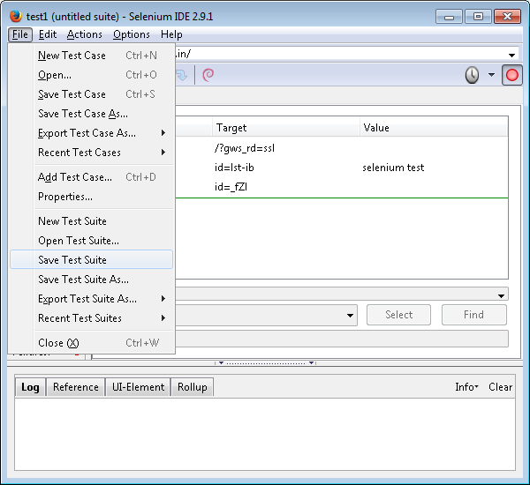
Creating and saving
test suites

Slide 12
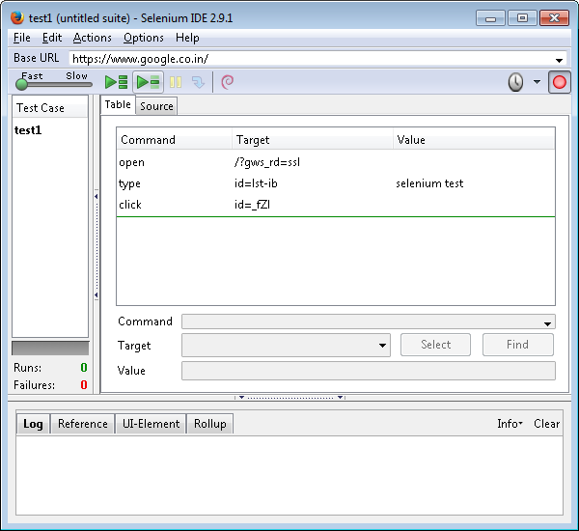
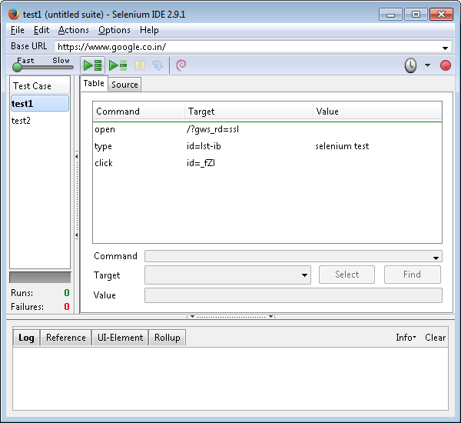
Running the
test/test suite
To run a single test
To execute all tests/suite

Slide 13
Pop Up Quiz
What drives Selenium IDE?
Does Selenium IDE works on Internet Explorer?
What are the ways to open Selenium IDE?
Why do we need to have Test Suites?
Applications of IDE.

Slide 14
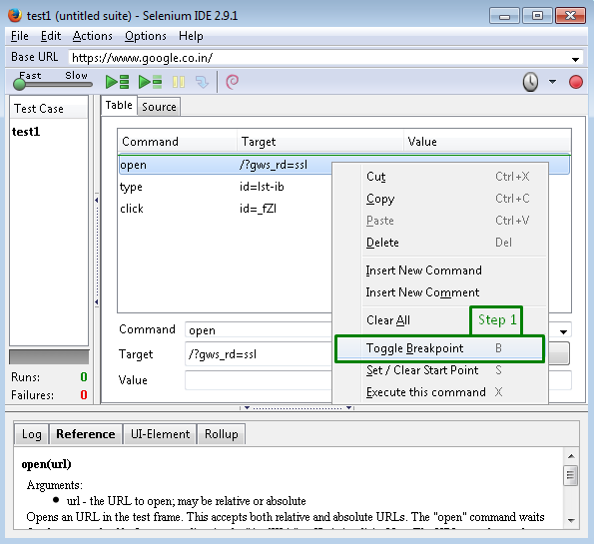
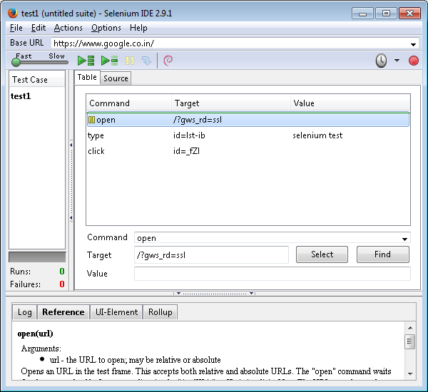
Running a script
line by line

Slide 15

Running a script
line by line
Step 2: Click to run test case
Step 3: Click blue step icon

Slide 16
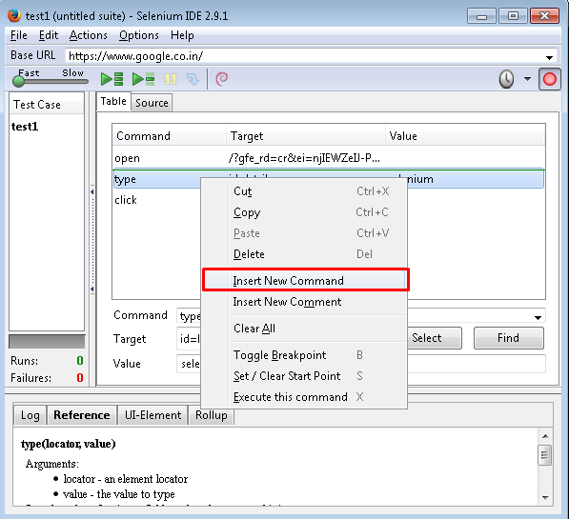
Inserting commands
in between script

Slide 17
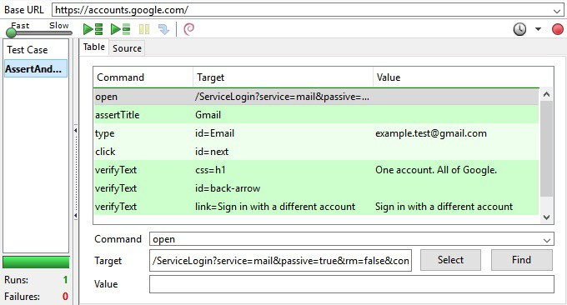
Introduction Verification
and Asserts

Slide 18


Slide 19
Knowledge Check
Difference between Verification and Assertion?
What are the challenges with Selenium IDE?

Slide 20

Thank you!

